Slide 1
HTML, WebElements,
& DOM Relationship
Trainer: Rex Jones II

Slide 2

Lesson Plan
Relationship Between HTML, WebElements, & DOM
Use Selenium Locators To Find WebElements
Create Customized XPath Values For Selenium
Create Customized CSS Selector Values For Selenium

Slide 3
Lesson Plan
Relationship Between HTML, WebElements, & DOM
Use Selenium Locators To Find WebElements
Create Customized XPath Values For Selenium
Create Customized CSS Selector Values For Selenium

Slide 4
HTML

Slide 5
WebElements

Slide 6
Document Object
Model (DOM)

Slide 7
Document Object Model (DOM)
Identify How To Access An HTML Document
Identify How To Manipulate An HTML Document
Identify The Logical Format Of An HTML Document

Slide 8
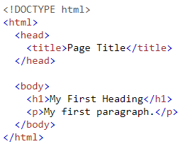
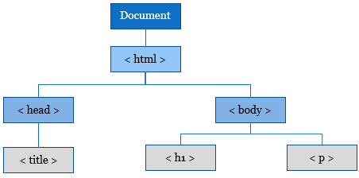
Document Object Model (DOM)
HTML Document
DOM Hierarchy

Slide 9
Lesson Plan
Relationship Between HTML, WebElements, & DOM
Use Selenium Locators To Find WebElements
Create Customized XPath Values For Selenium
Create Customized CSS Selector Values For Selenium

Slide 10
Selenium Locators
To Find WebElements
Trainer: Rex Jones II

Slide 11
Selenium
Locators

Slide 12
Selenium Locators
className
cssSelector
id
linkText
name
partialLinkText
tagName
xpath

Slide 13
Selenium Locators
To Find WebElements

Slide 14
Ranking of
Selenium Locators

Slide 15
Selenium Locators Rankings
id
name
clasName
linkText
partialLinkText
tagName

Slide 16
Selenium Locators Rankings
id
name
clasName
xpath or CSS Selector
linkText
partialLinkText

Slide 17
Lesson Plan
Relationship Between HTML, WebElements, & DOM
Use Selenium Locators To Find WebElements
Create Customized XPath Values For Selenium
Create Customized CSS Selector Values For Selenium

Slide 18
Create Customized XPath Values
Trainer: Rex Jones II

Slide 19
Create Customized XPath Values
Absolute XPath vs Relative XPath
XPath Functions
XPath Axes

Slide 20
Absolute vs
Relative XPath

Slide 21
Absolute vs Relative XPath
Absolute Syntax
/html/head/next child element/…
html/body/next child element/…
Relative Syntax
//TagName[@Attribute=‘Value’]

Slide 22
XPath Logical
Conditions & Indexes
Trainer: Rex Jones II

Slide 23
XPath
Functions

Slide 24
XPath
Axes

Slide 25
Lesson Plan
Relationship Between HTML, WebElements, & DOM
Use Selenium Locators To Find WebElements
Create Customized XPath Values For Selenium
Create Customized CSS Selector Values For Selenium

Slide 26
Create Customized
CSS Selectors
Trainer: Rex Jones II

Slide 27
Lesson Plan
Relationship Between HTML, WebElements, & DOM
Use Selenium Locators To Find WebElements
Create Customized XPath Values For Selenium
Create Customized CSS Selector Values For Selenium

Slide 28
Customized
CSS Selector Values

Slide 29
Advanced
CSS Selectors

Slide 30
Lesson Plan
Relationship Between HTML, WebElements, & DOM
Use Selenium Locators To Find WebElements
Create Customized XPath Values For Selenium
Create Customized CSS Selector Values For Selenium

